Slide 1
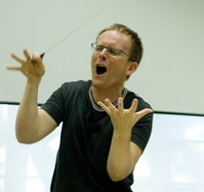
Foundations in conducting
Three sessions
#1 Tuesday July 9, 7-10 pm
#2 Saturday July 13, 6-9 pm
#3 Tuesday July 16, 7-10 pm
This class
Review!
Continue basic techniques: focus on your skills
Much practice in class
Last class: bring your conducting problems
Why study technique?
Show more, talk less!
Notes:
Do demo with changing dynamics, speed, fermatas, articulations

Slide 2
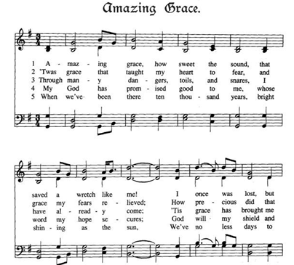
Big picture…
There is no right way to conduct a passage
The guiding principle for conductors should be…
What does the choir need from us right now, in this passage
Do they need…
Clear ictus
Line
Focus on intonation and/or rhythm
Imagination stimulation for meaning
So, why study technique…
So you can show more, talk less!

Slide 3
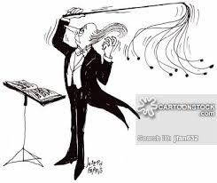
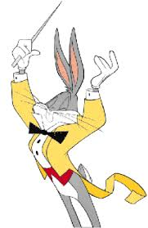
Review
Posture, arm/hand positions
4- and 3-beat patterns
Preparatory gestures
Articulations: legato, staccato, etc.
New
Dynamic changes gradual: right hand & left hand
Dynamic changes subito
Fermatas

Slide 4
Arm and hand position

Slide 5
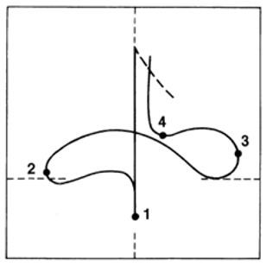
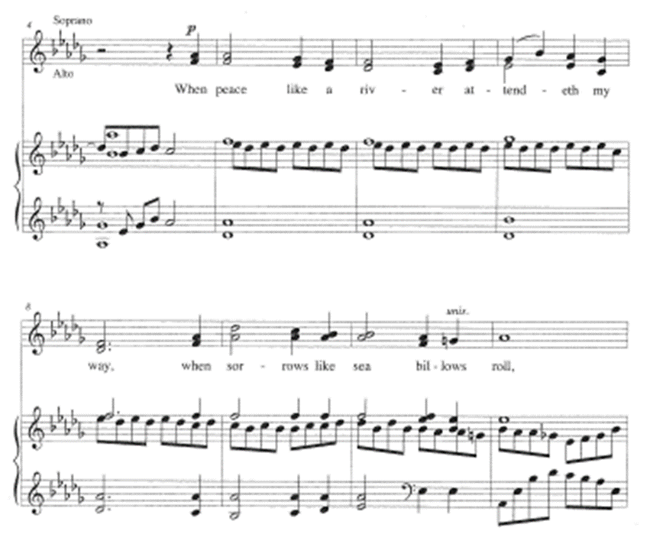
The basic four-beat pattern
Notes:
Also show on white board, including horizontal and vertical planes

Slide 6
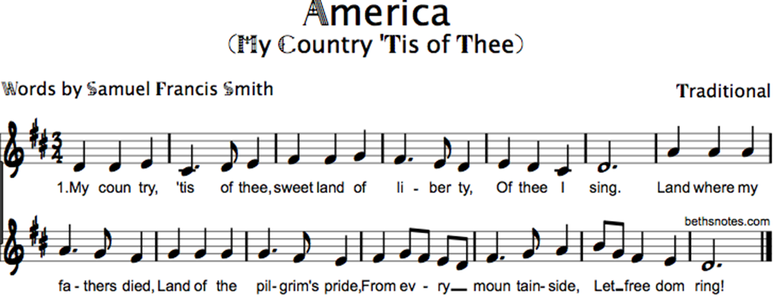
The Three-beat pattern

Slide 7
Practice preps

Slide 8
More practice preps

Slide 9
Articulation types: legato

Slide 10
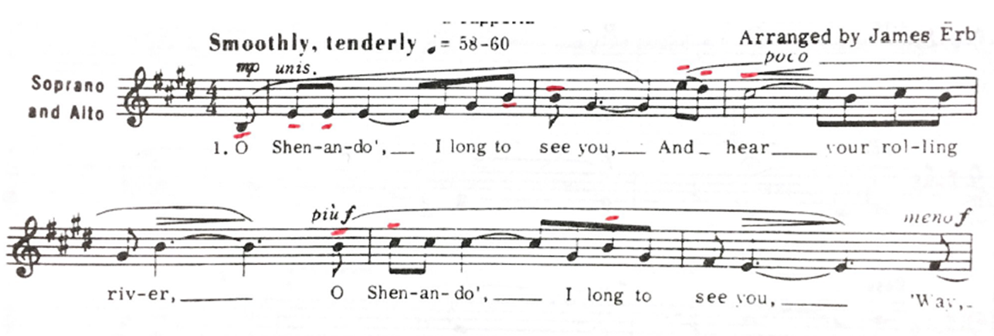
Articulation types: staccato
Articulation types: tenuto

Slide 11
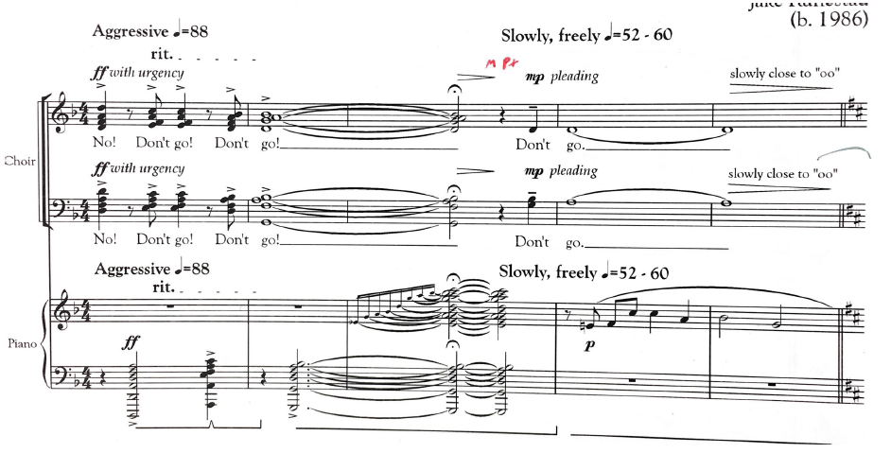
Articulation types: marcato

Slide 12
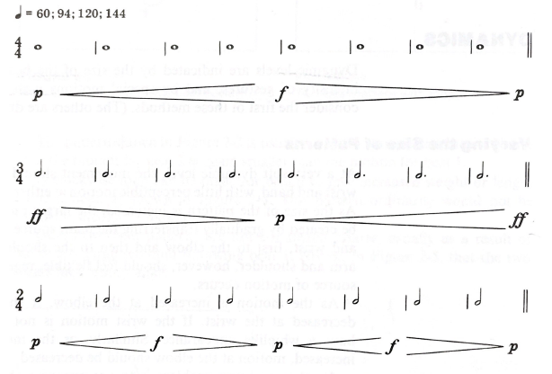
Right-hand dynamics: gradual
Wrist—Elbow—Shoulder

Slide 13
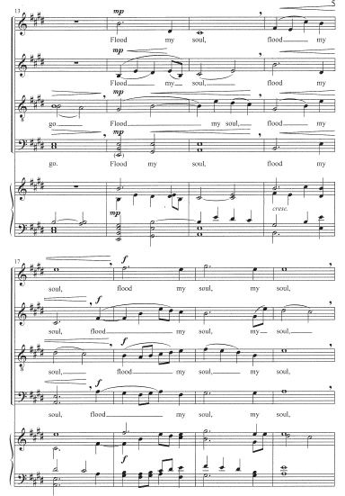

Slide 14
Right-hand dynamics: subito
Notes:
Subito: Where does the change occur?

Slide 15
Left-hand dynamics: gradual

Slide 17
Left-hand dynamics: subito
Notes:
Subito: Where does the change occur?

Slide 18
Fermatas
Three types
Hold + full stop (caesura):
Hold + No Breath and continue:
Hold + cut-off and continue:
(end of cut = start of prep)
Notes:
Also: 1-2-3-4 1-2-3-4 1-2-3-4 1-2-3-4 on white board, with moving fermata

Slide 19
Fermata I: Hold + full stop (caesura)

Slide 20
Fermata II: hold but no break

Slide 21
Fermata III: hold + breath in tempo, no pause
The real challenge!

Slide 22
Right-hand cues
Eye contact
Minimize two beats ahead
Prep one beat ahead

Slide 23
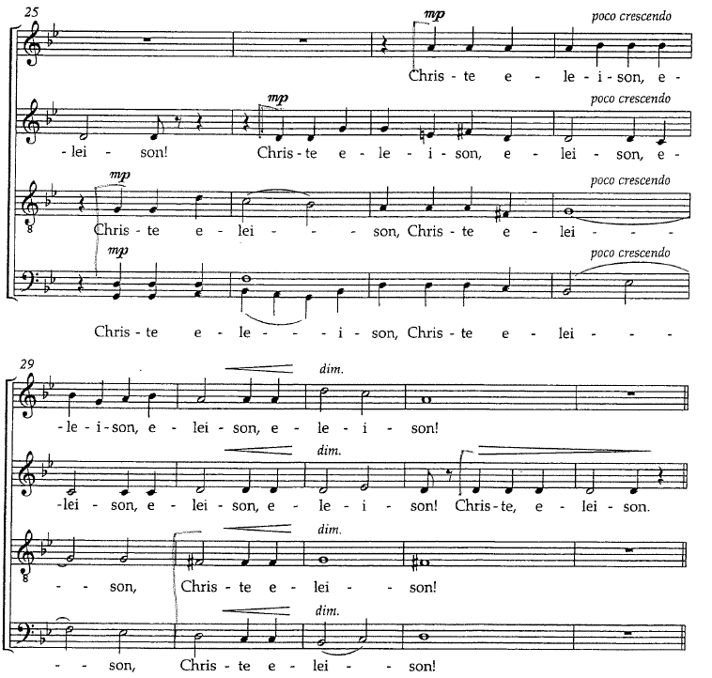

Slide 24
Left-hand cues
Eye contact
Left hand at attention two or more beats ahead of cue
Begin prep one beat early, including breath
Cue arrives on ictus of new entrance

Slide 25
Left-hand cues in real music

Slide 27
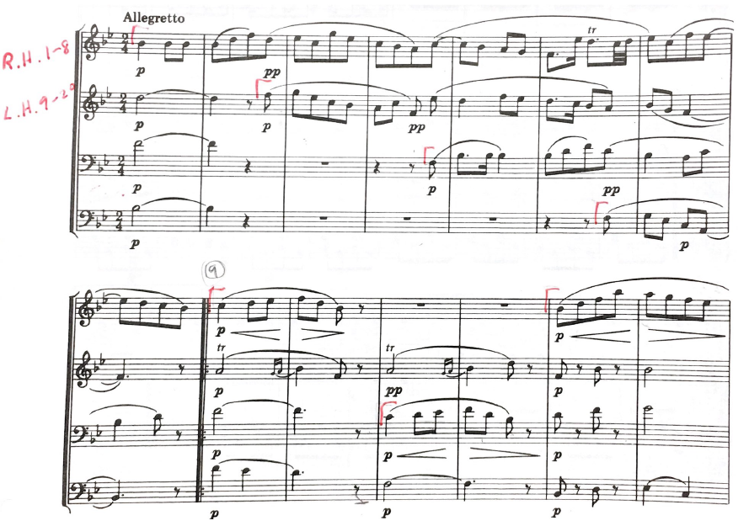
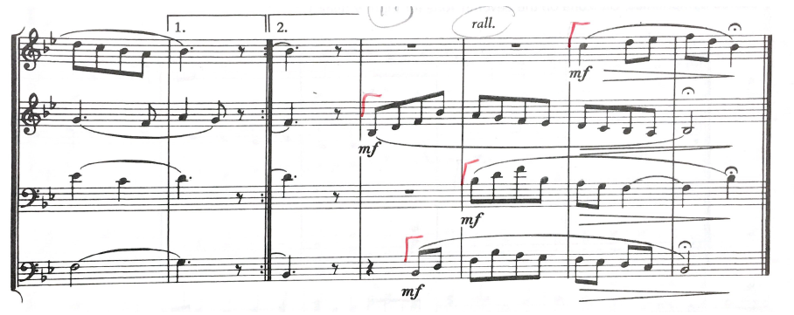
R.H & L.H. cue challenge!

Slide 28
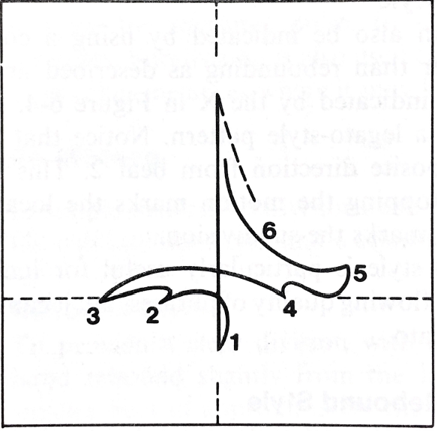
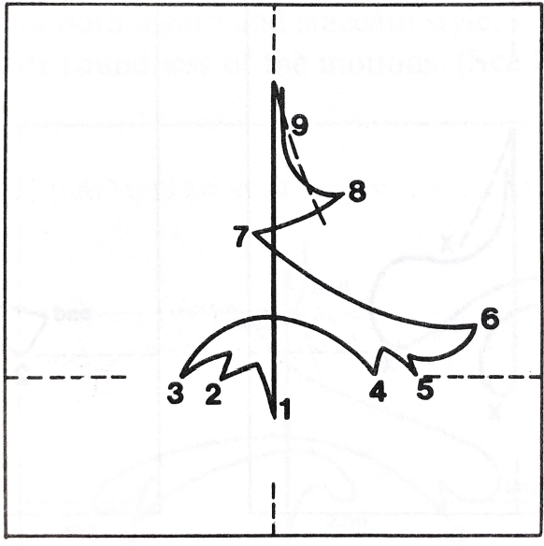
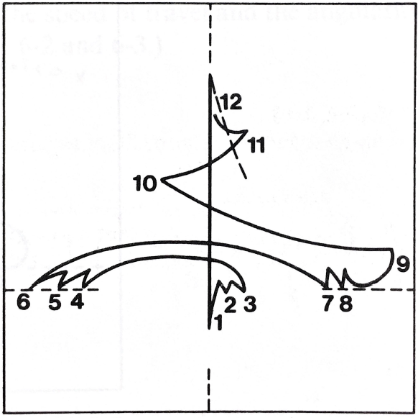
Compound meters
6/8
9/8
12/8

Slide 30
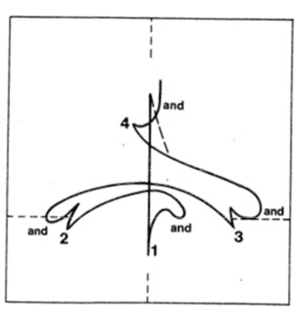
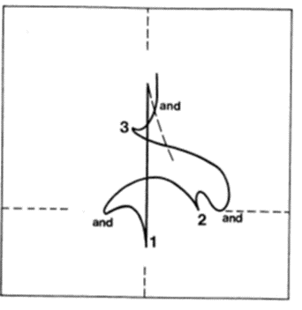
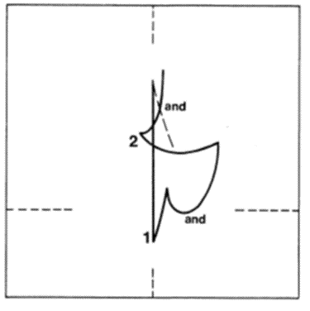
Divided meters
4/4
3/4
2/4

Slide 33
Possible topics for next class
Cuts: all types
Your topics/problems/questions/requests
Score preparation:
getting inside the music
Getting the music inside you
Some general principles of rehearsal
Choral tuning
Voice-building exercises

Slide 34
Your opportunity for input!
Send me your ideas for next class
What topics or skills
What are conducting problems that you have
Send to tholmchor@gmail.com
Send by Monday!

